Slide 1
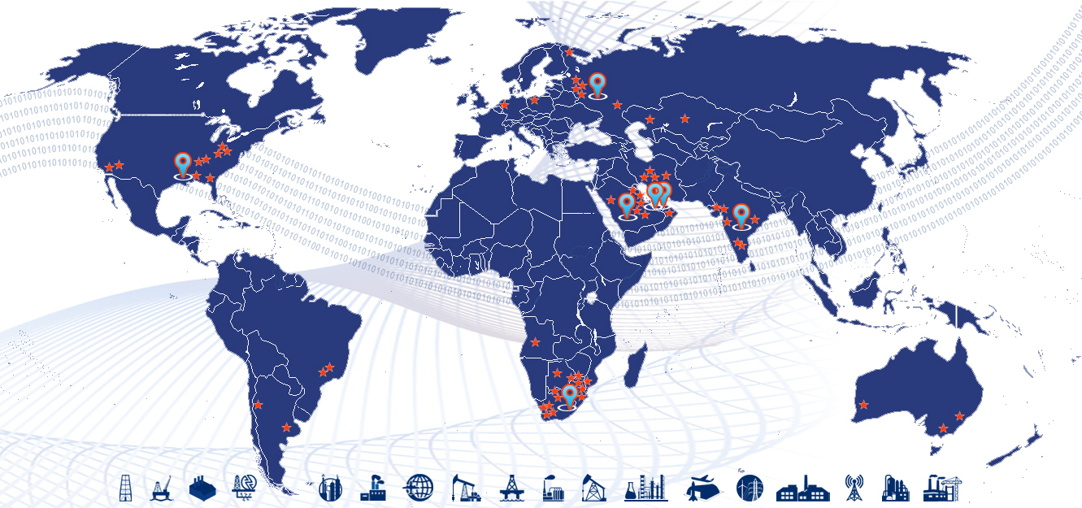

Material Master Taxonomy & ISO Standards
PiLog Group - Confidential
2025/12/22

Slide 2

ISO – International Organization for Standardization
156 National standard organization members (one per country)‏
(AFNOR, ANSI, BSI CNIS, DIN, GOST, SABS, SASO ……….)‏
Central Secretariat in Geneva
150 staff
192 Technical Committees
3 000 Technical bodies
50 000 domain experts* (*you can become an ISO expert )
ISO TC 184 - Automation systems and integration
Standardization in the field of automation systems and their integration for design, sourcing, manufacturing and delivery, support, maintenance and disposal of products and their associated services. Areas of standardization include information systems, robotics for fixed and mobile robots in industrial and specific non-industrial environments, automation and control software and integration technologies.
ISO TC 184 SC4: ISO 8000 data quality - ISO 22745 exchange of quality data

Slide 3
ISO Standards Development Process
New Work Item (NWI) Ballot simple majority and at least 5 countries supporting
Committee Draft (CD) Ballot 2/3 majority
Draft International Standard (DIS) Ballot 2/3 majority
Final Draft International Standards (FDIS)Ballot 2/3 majority
International Standard (IS)
A two year (minimum) process designed to ensure international consensus

Slide 4
Master Data Quality Standards
Data Portability
ISO 8000
Data Portability
Data Requirement
ISO 8000-110
Class/Concept Definition, unique identifier
Quality data is portable data; it is independent of the software application
Data Terminology & Localization
PPO-OTD: ISO 8000-110
Common Business Language
Data Classification
ISO 22745
Linking PPO class to classification (UNSPSC)
Provenance – Traceable History at record level
Data Traceability
ISO 8000-120
Property/Concept Definition, unique identifier
Business Requirements
Multi-lingual
Linking PPO class to classification (spend tree)
Technical Dictionaries & Exchange of Characteristics Data
ISO 29002
Technical Dictionaries
Exchange of characteristics data in xml format
Owner of the data created
ISO 8000
Master Data Quality
ISO 22745
Open Technical Dictionaries
ISO 29002
Exchange of Characteristics data

Slide 5
ISO 8000 Family of Standards
ISO 8000
General Principles
Part 1 Introduction
Part 2 Terminology
Master Data
Part 110
Syntax
Semantic encoding
Meets requirements
Part 120 Provenance
Part 130 Accuracy
Part 140 Completeness
Transaction data
Wisdom
Knowledge
meaningful information
Information meaningful data
Data a datum is a disruption in a continuum

Slide 6
ISO 8000 – 110 Syntax
Master Data
Part 110
Syntax
There must be one!
It must be referenced in the data and the reference must be resolvable to the syntax, if it is not freely available the data must be labeled ISO 8000-110:2009 fee based encoded.
EDI (ISO 9735), ebXML, SWIFT MT, SWIFT MX, ISO 20022, eOTD-r-xml (ISO 22745) are all acceptable syntaxes

Slide 7
ISO 8000 – 110 Semantic Encoding
Master Data
Part 110
Semantic encoding
All metadata must be explicitly defined either in an external open dictionary or the definition must be contained in the data. if it is not freely available the data exchange must be labeled as ISO 8000-110:2009 fee based encoded.
Any defined metadata is acceptable. This includes the field, headings or attributes that are “explicitly defined” in electronic forms, spreadsheets or database tables.

Slide 8
ISO 8000 – 110 Meets Requirements
Master Data
Part 110
Meets requirements
Requirements support a business function, granting access to a computer, a website or a software program, simply asking for the data needed to deliver the right product or service, these are all data requirements
As long as the data meets the requirements it is considered quality data
Be careful what you ask for – data quality starts with the quality of the request for data

Slide 9
ISO 8000 - 110 Standard
Data that meets requirements
Data that is unambiguously encoded
Data that is application independent
ISO 22745 is a standard for the exchange of ISO 8000 quality data

Slide 10
General Requirements for ISO 8000
According the ISO 8000-110 standards, a master data message must meet six general requirements
Part 1a: The master data message shall unambiguously state all information necessary for the receiver to determine its meaning
Part 1b: A formal syntax must be specified using a formal notation
Part 1c: Any data specification required by the message shall be in a computer interpretable language
Part 1d: The message must explicitly indicate both the data specifications it fulfils and the formal syntax (or syntaxes) to which it complies
Part 1e: It must be possible to check the correctness of the master data message against both its formal syntax and its data specification
Part 1f: The references within the master data message to data dictionary entries must be in the form of unambiguous identifiers conforming to an internationally recognized scheme
PiLog 22-12-2025

Slide 11
How to become compliant to ISO 8000 standard
Document your business language
Map your business language to the Technical Dictionary
Document your requirements for data (Templates)
Create your Master Data Taxonomy
Terminology
Data requirements
Classification/Categorization
Measure the quality of your master data
(by comparing your data to your requirements for data)

Slide 12

ISO 8000 QMDP Certification
The requirements for the Quality Master Data Provider (organization) certification
Develop and publish data requirements in eOTD-i-xml (ISO 22745-30)
Decode and Send master data in eOTD-r-xml (ISO 22745-40)
Generate queries in eOTD-q-xml (ISO 22745-35)
Respond to queries using eOTD-r-xml
Validate master data in eOTD-r-xml for compliance with data requirements in eOTD-i-xml

Slide 13
Characteristics of Data Quality
Data Quality
Completeness
Accuracy
Consistency
Availability
Timeliness
Traceability
PiLog 22-12-2025

Slide 14
What is Ontology?
In computer science and information science, an ontology is a formal naming and definition of the types, properties, and interrelationships of the entities that really or fundamentally exist for a particular domain of discourse
Ontology is the complete set of concepts, its terminology, definitions, abbreviations, data requirements, unit of measures etc and interrelationships of these entities
PiLog 22-12-2025
Notes:
14

Slide 15
What is Concept?
Concept shall mean the unit of thought or knowledge constituted by a unique set of necessary characteristics (characteristic that is always true of each object in the extension of a given concept)
“A Concept is something that one can Conceive or Perceive”
IRDI shall mean International Registration Data Identifier that is used to uniquely identify a concept globally. This has to be as per the requirements stipulated in ISO/IEC 11179-5 & ISO/IEC 6523, IRDI consists of three parts: 1) registration authority identifier (RAI); 2) data identifier (DI); 3) version identifier (VI).
PiLog 22-12-2025
Notes:
15

Slide 16
Ontology Need ?
Enterprises require an Ontology to manage the master data
Nature of Business Operations
E-Commerce Portals
Multiple ERP Systems
Laws of Land (Compliance/Regulatory/Standard)
Transactional/Business Language
Multi-National Operations
Master Data Quality
Data Dictionary
PiLog 22-12-2025
Notes:
16

Slide 17
Ontology Capabilities
Good Ontology should be able to
Data Exchange – Enterprises & Systems (Interoperability)
Automatic Integration & Syndication
Provide Portability
Define Syntax & Semantics
Conforms to the Data Requirements
Computer Readable & Resolvable
Unambiguously define Meta Data
Automate Data Quality Evaluation
Derive Information Quality
Scalable Data Model
22-12-2025
PiLog 22-12-2025
Notes:
17

Slide 18
Ontology Business Benefits
Uniformity in Business Communication
Accurate & Cost Effective Sourcing
Unambiguous Identification
Consistent Sales & Purchase Order Descriptions
Potential Duplicate Identification
Visibility of Spend
Optimized Inventory & Supply-Chain Management
Standardized processes
PiLog 22-12-2025
Notes:
18

Slide 19
Master Data Dictionary
Terminology
Definition
Abbreviation
Language
Data Type
Image
Data Requirement
Class
Characteristics
Required (Y/N)
Characteristic UOM
PiLog 22-12-2025
Notes:
19

Slide 20
Concept – Term – Definition – Abbreviation - Language
Abbr1-Abbr Id1
Term1-Term Id1
Language Id1
Abbr2-Abbr Id2
Abbr n-Abbr Id n
Definition 1
Definition Id 1
Term2-Term Id2
Language Id2
Definition 2
Definition Id 2
Concept
Concept Id
Definition n
Definition Id n
Term3-Term Id3
Language Id3
Image 1
Image 2
Term n-Term Id n
Language Id n
Image 3
PiLog 22-12-2025
Notes:
20

Slide 21

Taxonomies & Standards in the market
Shell MESC
Noun
Modifier
Code
Class
Intermat SMD
NAG
Noun
Noun Synonyms
Modifier
Characteristics
Trade Ranger
Category
Group
Noun/Modifier
Attribute 1 … 25
eCl@ss
Class
Attribute
Value
RUS
Classification
Attributes Native
Template Attributes
Customer Attributes
PiLog Taxonomy
PPO-OTD
(ISO 22745, ISO 8000)
Discipline
(Material /Service Group)
Verb-Noun-Modifier
Action-Object-Qualifier
Properties/Characteristics
Reference Data
Documentation Data
Sourcing Info
Conversion
Languages
SMD changes
Industry changes
Company changes
UNSPSC
Segment
Family
Class
Commodity
Item Description
NATO
(NSN/FIIG)
Group
Class
NCB
IIG
Item Name
ESCI (Class)
ESPI (Properties)
External References
(H2, H6, INC, MRC)
AUSLANG
(OSD)
Group
Item Name
Attributes
Others
EAN
UDCI
ISBN

Slide 22
Enterprise Ontology Syndication
PiLog Preferred Ontology
(PRO & PPO)
PiLog OTD Registry
Client Preferred Ontology (CPO)
Dictionary
(PRO)
OTD
ISO 22745
ISO 8000
ISO 22745
ISO 8000
∏ OTD
Dictionary
(PPO)
Dictionary
ISO 22745
ISO 8000
Concept Types
Class : BEARING, BALL
Property: INSIDE DIAMETER
UOM: INCH, MM, CM
Property Value: 24, 40, ANNULAR
Currency: $, £, €
QOM: Nominal, Min, Max
DR (Templates)
DR (Templates)
DR (Template)
Class + Class definition + Abbreviation
Property + Prop def + Prop Abbr + Mandatory Ind + data type + description indicator + Sequence
PiLog 22-12-2025
Notes:
22

Slide 23
OTD – PRO – PPO – CPO
PPO
(PiLog Preferred Ontology)
PRO
(Ontology of all PiLog Clients)
OTD Registry
(Over 1.4 million concepts)
CPO
(Client/Corporate Preferred Ontology)
ISO 22745 & ISO 8000 Complaint
PiLog 22-12-2025
Notes:
23

Slide 24
Taxonomy Data Classification
Data
Master data describes entities that the organization needs to referenced in order to perform transactions
Transactional data
Reference data references to another organization’s master data
Characteristic data characteristics of the entity being described
Physical characteristics
Performance characteristics (capabilities)
Notes:
24

Slide 25








Technical Capabilities
4600+ Material
1600+ Service
4600+ Uniquely defined MRO templates in PPO – PiLog Taxonomy/Dictionary
Translation of taxonomy/dictionary available in 18 Languages across industry sectors
PPO to UNSPSC mapping readily available
PPO to HSN Codes mapping readily available
Each template has Class, Characteristics, Abbreviations, Definitions, Standard Values, Mandatory indicators, sequence & preference indicators
PPO taxonomy/dictionary is managed in Cloud for all customers around the globe
Each Class has multiple images/pictures linked for easy identification
1600+ Uniquely defined Service master templates
Predefined Categories, Groups (UNSPSC) mapped with Classes for Service Master
PPO – Dictionary developed & managed as per ISO principles by Industry Experts
Each Technical Term has Global Unique Identifiers for resolution
Value added members of standards organizations such as ECCMA, UNSPSC etc

Slide 26
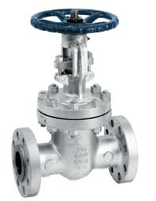
Example: Multi-Lingual Terminology
Concept: VALVE, GATE
Term (English): VALVE, GATE (or) GATE VALVE
Term (French): VALVE, À TIROIR
Term (Italian): VALVOLA A SARACINESCA
Definition (English): A valve designed to control flow by a flat tapered oval or rectangular shaped slide (gate), which slides over a seat and may contain thermal relief features that is manually, motor or pressure operated.
Definition (French): Une soupape destinée à commander l'écoulement d'un coulisseau plat conique de forme ovale ou rectangulaire (grille), qui glisse sur un siège, ou contenir des caractéristiques thermiques de secours qui est manuellement, à moteur ou à commande par pression.
Definition (Italian): Valvola progettata per controllare il flusso tramite un dispositivo piatto e affusolato di forma ovale o rettangolare (saracinesca) che scorre in una guida. Può contenere sistemi di alleviamento termico manuali, a motore o a pressione.
PiLog 22-12-2025
Notes:
26

Slide 27
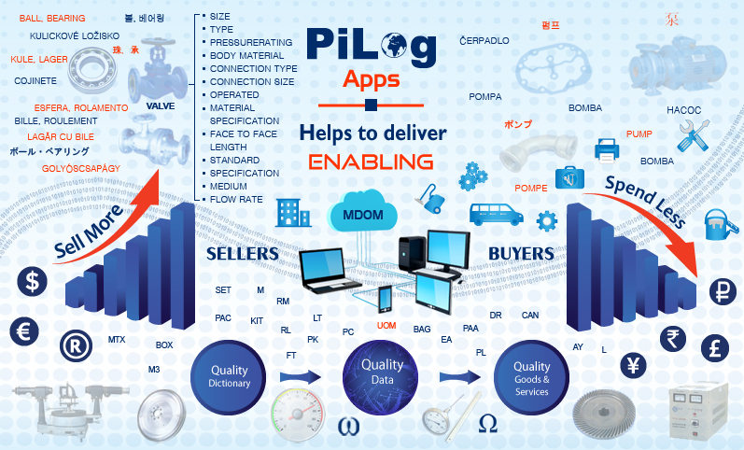
PiLog Solution – Master Data Ontology Manager
PiLog 22-12-2025
Notes:
27

Slide 28
Enterprise Ontology Management
Dictionary Manager
Search Open Technical Dictionary
Data Requirement Manager
Classification Manager
Classify the PPO Class
Build own dictionary for the organization
Search PiLog Preferred Dictionary
Search PiLog Registered Dictionary
View & add images to the dictionary
Map with UNSPSC
Understand & Evaluate Spend
Build material groups based on UNSPSC
Propagate templates across organization
Build product or service templates
Enforce data quality via templates
Build data requirements(templates) on the fly
Compare data requirements templates)
PiLog 22-12-2025
Notes:
28

Slide 29
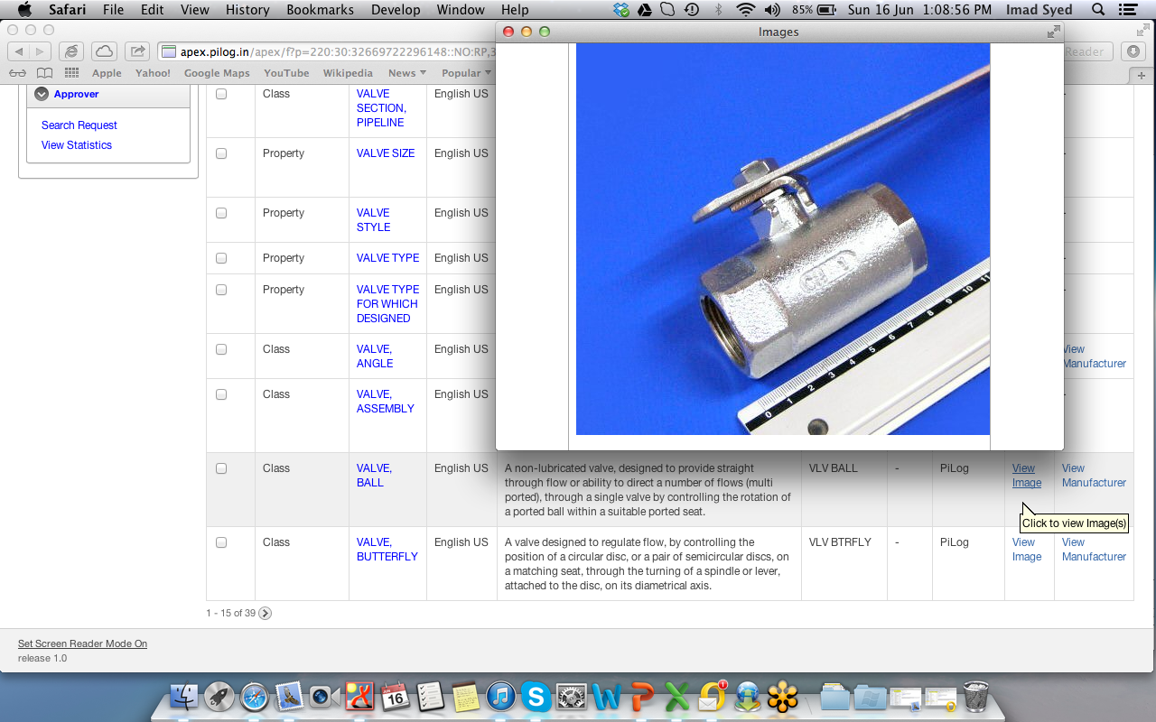
Example: Data Dictionary - Products
PiLog 22-12-2025
Notes:
29

Slide 30
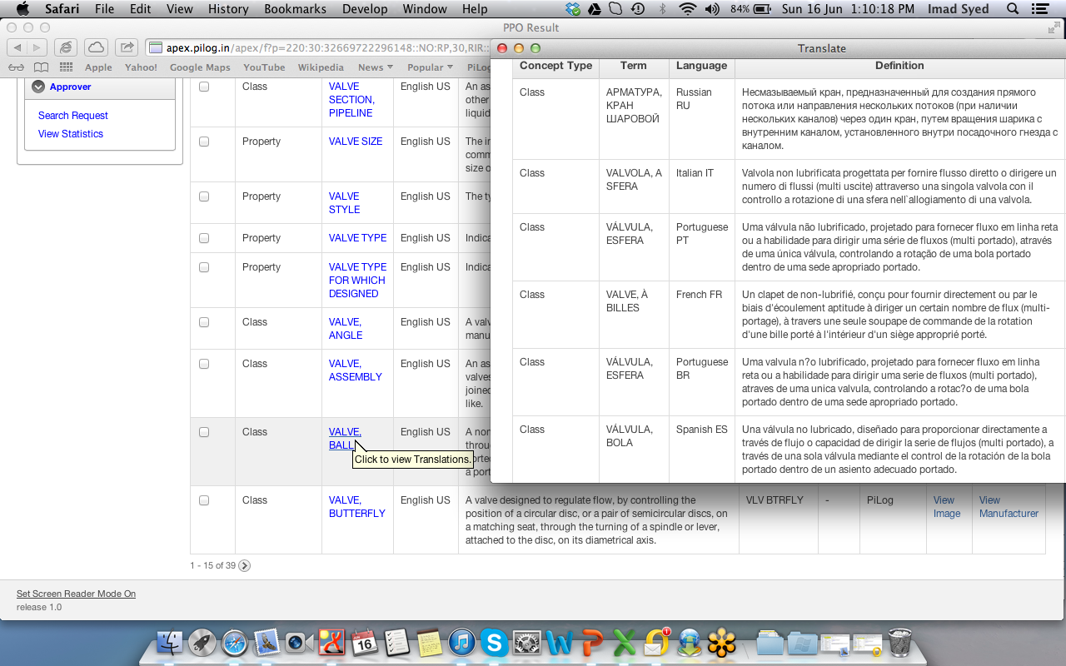
Example: Multi-Lingual Terminology
PiLog 22-12-2025
Notes:
30

Slide 31
UNSPSC Classification
UNSPSC Code: 24101712
Hierarchy Category | Number | Name or Description
Segment | 24 | Material Handling and Conditioning and Storage Machinery and their Accessories and Supplies
Family | 10 | Material handling machinery and equipment
Class | 17 | Conveyors and accessories
Commodity | 12 | Belt conveyors
24 Segment: Material Handling and Conditioning and Storage Machinery and their Accessories and Supplies
10 Family: Material handling machinery and equipment
17 Class: Conveyors and accessories
12 Commodity: Belt Conveyors
PiLog 22-12-2025
Notes:
31

Slide 32
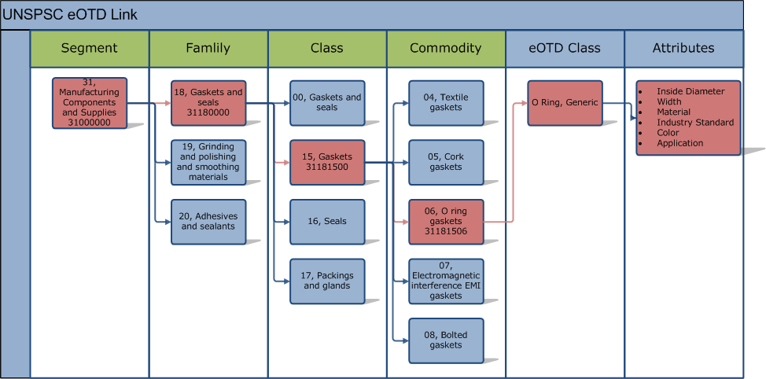
PPO-UNSPSC Classification
PPO Class
Properties
PiLog 22-12-2025
Notes:
32

Slide 33
PPO-PiLog Preferred Ontology
PiLog Preferred Ontology has the proven record that it has the capabilities to address all the objectives
Class Name (Noun & Modifier Pairs)
Class Definition
Class Abbreviation
Class Image(s)
Template Name (Data Requirement for procurement)
Property Name
Property Definition
Property Abbreviation
Property Sequence
Property Importance
Property Data type
PiLog 22-12-2025

Slide 34
Example: Data Requirement - Products
VALVE, BALL
 | TYPE | O | STRING_TYPE
 | SIZE | M | STRING_TYPE
 | STYLE | O | STRING_TYPE
 | PRESSURE RATING | M | MEASURE_NUMBER_TYPE
 | MEDIUM | O | STRING_TYPE
 | FLOW RATE | O | MEASURE_NUMBER_TYPE
 | TEMPERATURE RATING | O | MEASURE_RANGE_TYPE
 | CONNECTION SIZE | M | MEASURE_NUMBER_TYPE
 | CONNECTION TYPE | M | STRING_TYPE
 | PORT TYPE | M | STRING_TYPE
 | OPERATED | M | STRING_TYPE
 | FACE TO FACE LENGTH | O | MEASURE_NUMBER_TYPE
 | DIMENSIONS | O | STRING_TYPE
 | BODY MATERIAL | M | STRING_TYPE
 | TRIM | M | STRING_TYPE
 | SOFTGOODS | O | STRING_TYPE
 | LINING MATERIAL | O | STRING_TYPE
 | MOUNTING METHOD | O | STRING_TYPE
 | STEM DESIGN | O | STRING_TYPE
 | SPECIAL FEATURES | O | STRING_TYPE
 | APPLICATION | O | STRING_TYPE
 | SPECIFICATION | O | STRING_TYPE
 | STANDARD | O | STRING_TYPE
PiLog 22-12-2025
Notes:
34

Slide 35
Example: Multi-Lingual Data Requirement
VALVE, BALL | VENTIL, KUGEL (German) | VALVE, À BILLES (French) | VALVOLA, A SFERA (Italian)
SIZE | GROESSE | TAILLE | MISURA
PRESSURE RATING | DRUCKSTUFE | CLASSEMENT PRESSION | PRESSIONE DI PROGETTAZIONE
BODY MATERIAL | RUMPFMATERIAL | MATÉRIAUX DU CORPS | MATERIALE CORPO
CONNECTION TYPE | VERBINDUNGSART | TYPE DE RACCORD | TIPO DI CONNESSIONE
CONNECTION SIZE | VERBINDUNGS GROESSE | CONNECTEUR TAILLE | DIMENSIONE CONNESSIONE
OPERATED | BETRIEBEN | COMMANDE | COMANDO
PORT TYPE | HAFENART | TYPE DE PORT | PORT TIPO
TRIM | VERKLEIDUNG | TRIM | TRIM
TYPE | TYP | TYPE | TIPO
MATERIAL SPECIFICATION | MATERIALSPEZIFIKATION | SPÉCIFICATION DES MATÉRIAUX | SPECIFICHE MATERIALE
MATERIAL GRADE | MATERIALSTUDE | CLASSE DE MATÉRIAU | GRADO MATERIALE
LINING MATERIAL | FUTTERMATERIAL | MATÉRIAU DE REVÊTEMENT | MATERIALE DI RIVESTIMENTO
SOFTGOODS | WEICHE WAREN | BIENS NON DURABLES | MATERIALI SOFFICI
FACE TO FACE LENGTH | GESICHT ZU GESICHT DISTANZ | FACE À FACE LONGUEUR | LUNGHEZZA FACCIA A FACCIA
TEMPERATURE RANGE | TEMPERATURBEREICH | GAMME DE TEMPERATURE | RANGE DI TEMPERATURA
DUTY | PFLICHT | DEVOIR | SERVIZIO
APPLICATION | ANWENDUNG | CANDIDATURE | APPLICAZIONE
MEDIUM | MITTEL | A MOYEN | ELEMENTO
FLOW RATE | FLIESSRATE | DEBIT TAUX | PORTATA TASSO
MOUNTING METHOD | MONTAGEART UNTER | MONTAGE DE MÉTHODE | METODO DI MONTAGGIO
SPECIAL FEATURES | SPEZIELLE EIGENSCHAFTEN | PARTICULARITES | CARATTERISTICHE SPECIALI
SPECIFICATION | SPEZIFIKATION | CAHIER | SPECIFICHE
PiLog 22-12-2025
Notes:
35

Slide 36
Example: Master Data Record
VALVE, BALL | Property Value | Value UOM
SIZE | 1/4 | IN
PRESSURE RATING | CL 150 | N/A
BODY MATERIAL | CARBON STEEL | N/A
CONNECTION TYPE | NPT | N/A
CONNECTION SIZE | 1/4 | IN
OPERATED | WHEEL | N/A
PORT TYPE | FULL BORE | N/A
TRIM | BALL: SS 316, STEM: SS 316 | N/A
TYPE | LOW PRESSURE | N/A
MATERIAL SPECIFICATION | ASTM A105 | N/A
MATERIAL GRADE | B | N/A
LINING MATERIAL | TEFLON | N/A
SOFTGOODS | SEAL: NBR, PACKING: GRAFOIL | N/A
FACE TO FACE LENGTH | 150 | MM
TEMPERATURE RANGE | -30 TO 100 | DEG C
DUTY | HEAVY | N/A
APPLICATION | CENTRIFUGAL PUMP | N/A
MEDIUM | WATER | N/A
FLOW RATE | 16 | L/MIN
MOUNTING METHOD |  | N/A
SPECIAL FEATURES |  | N/A
SPECIFICATION |  | N/A
PiLog 22-12-2025
Notes:
36

Slide 37
Example: Multi-Lingual Descriptions
English | VLV,BALL;1/4IN,CL150,CS,NPT,1/4IN,WHL
English | VALVE, BALL; SIZE: 1/4 IN, PRESSURE RATING: CL 150, BODY MATERIAL: CARBON STEEL, CONNECTION TYPE: NPT, CONNECTION SIZE: 1/4 IN, OPERATED: WHEEL, PORT TYPE: FULL BORE, TRIM: BALL: SS 316, STEM: SS 316, TYPE: LOW PRESSURE, MATERIAL SPECIFICATION: ASTM A105, MATERIAL GRADE: B, LINING MATERIAL: TEFLON, SOFTGOODS: SEAL: NBR, PACKING: GRAFOIL, FACE TO FACE LENGTH: 150 MM, TEMPERATURE RANGE: -30 TO 100 DEG C, DUTY: HEAVY, APPLICATION: CENTRIFUGAL PUMP, MEDIUM: WATER, FLOW RATE: 16 L/MIN
German | VENTIL, KUGEL;1/4IN,CL 150,NPT,1/4IN
German | VENTIL, KUGEL; GROESSE: 1/4 IN, DRUCKSTUFE: CL 150, RUMPFMATERIAL: KOHLENSTOFFSTAHL, VERBINDUNGSART: NPT, VERBINDUNGS GROESSE: 1/4 IN, BETRIEBEN: FELGE, HAFENART: VOLLER DURCHGANG, VERKLEIDUNG: KUGEL: SS 316, STEM: SS 316, TYP: NIEDRIGER DRUCK, MATERIALSPEZIFIKATION: ASTM A105, MATERIALSTUDE: B, FUTTERMATERIAL: TEFLON, WEICHE WAREN: DICHTUNGS: NBR, VERPACKUNG: GRAFOIL, GESICHT ZU GESICHT DISTANZ: 150 MM, TEMPERATURBEREICH: -30 TO 100 DEG C, PFLICHT: HOCH, ANWENDUNG: KREISELPUMPE, MITTEL: WASSER, FLIESSRATE: 16 L/MIN
French | VALVE, À BILLES;1/4IN,CL 150
French | VALVE, À BILLES; TAILLE: 1/4 IN, CLASSEMENT PRESSION: CL 150, MATÉRIAUX DU CORPS: ACIER AU CARBONE, TYPE DE RACCORD: NPT, CONNECTEUR TAILLE: 1/4 IN, COMMANDE: ROUE, TYPE DE PORT: PASSAGE INTÉGRAL, TRIM: BOULE: SS 316, POTENCE: SS 316, TYPE: BASSE PRESSION, SPÉCIFICATION DES MATÉRIAUX: ASTM A105, CLASSE DE MATÉRIAU: B, MATÉRIAU DE REVÊTEMENT: TEFLON, BIENS NON DURABLES: JOINT: NBR, EMBALLAGE: GRAFOIL, FACE À FACE LONGUEUR: 150 MM, GAMME DE TEMPERATURE: -30 TO 100 DEG C, DEVOIR: LOURDE, CANDIDATURE: POMPE CENTRIFUGE, A MOYEN: D'EAU, DEBIT TAUX: 16 L/MIN
Italian | VALVOLA, A SFERA;0.25IN,CL 150
Italian | VALVOLA, A SFERA; MISURA: 0.25 IN, PRESSIONE DI PROGETTAZIONE: CL 150, MATERIALE CORPO: ACCIAIO AL CARBONIO, TIPO DI CONNESSIONE: NPT, DIMENSIONE CONNESSIONE: 0.25 IN, COMANDO: RUOTA, PORT TIPO: PASSAGGIO TOTALE, TRIM: PALLA: SS 316, GAMBO: SS 316, TIPO: BASSA PRESSIONE, SPECIFICHE MATERIALE: ASTM A105, GRADO MATERIALE: B, MATERIALE DI RIVESTIMENTO: TEFLON, MATERIALI SOFFICI: FOCA: NBR, IMBALLAGGIO: GRAFOIL, LUNGHEZZA FACCIA A FACCIA: 150 MM, RANGE DI TEMPERATURA: -30 TO 100 DEG C, SERVIZIO: PESANTE, APPLICAZIONE: POMPA CENTRIFUGA, ELEMENTO: ACQUA, PORTATA TASSO: 16 L/MIN
PiLog 22-12-2025
Notes:
37

Slide 38
Taxonomy/Dictionary Formulation Guidelines
Class Name should have clear cut definition to identify uniquely
The format should be “Noun, Modifier” not “Modifier, Noun”
VALVE, GATE is Correct
GATE, VALVE is Incorrect
No use of abbreviations in Class name
TRANSMITTER, DIFF PRESS
INDICATOR, TEMP
No ‘material’ in the Class name
BOX, PLASTIC
PIPE, STEEL
No synonyms or equivalence with existing Class name
BEARING, JOURNAL & BEARING, SLEEVE
WRENCH & SPANNER
PiLog 22-12-2025

Slide 39
Taxonomy/Dictionary Formulation Guidelines
Class Name
No Generic name in the Class name
FITTING
FASTENER
TOOL
No use of plurals in Class name
BEARINGS
ABRASIVES
No group/category name in the Class name
PUMPS & COMPRESSORS
MOTORS & GENERATORS
No property in the Class name
ADAPTER, TUBE TO FEMALE PIPE
BEARING, BALL, SEALED
PiLog 22-12-2025

Slide 40
Taxonomy/Dictionary Formulation Guidelines
Property Name with definition should be unique for the template
Property name should be one of the characteristics of the Class
No Reference type as property name
No ambiguity in the property name
Clear cut definition
Should be in UPPER case
No use of Class name with the property
Property name should enable the item to identify uniquely
No generic abbreviation or acronym as property name
No use of Unit of Measure as property name
Property name should help for the procurement of the item
PiLog 22-12-2025

Slide 41
Taxonomy/Dictionary Formulation Guidelines
Template should consist of all the properties associated with the Class that helps in procurement of the item uniquely
Each template should be unique in describing the class/item
Template should explain the characteristics of the class/item
No redundancy of characteristics within a template
No use of Class name with the property
Property should have definition
Each property should have mandatory or optional indicator for procurement
Each property should have priority of sequence to include in descriptions
Property should not be a reference type
Property should have a data type
Property should have applicable UOM
PiLog 22-12-2025

Slide 42
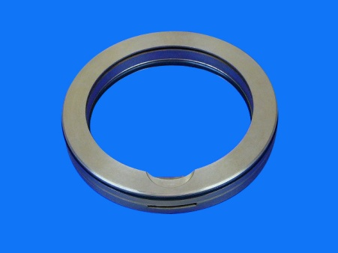
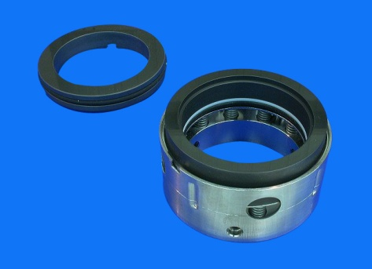
Template Comparison for SEAL
SEAL, LABYRINTH
SEAL, MECHANICAL
TYPE | M
BODY MATERIAL | M
MATERIAL GRADE | O
MATERIAL SPECIFICATION | O
SHAFT DIAMETER | M
MEDIUM | M
HEAD TYPE | M
HEAD DIAMETER | M
HEAD HEIGHT | M
HEAD MATERIAL | M
FACE TYPE | M
FACE SIZE | M
FACE MATERIAL | M
SPRING CONFIGURATION | O
SPRING MATERIAL | O
TEMPERATURE RATING | O
PRESSURE RATING | O
APPLICATION | O
SPECIFICATION | O
STANDARD | O
TYPE | M
INSIDE DIAMETER | M
OUTSIDE DIAMETER | M
THICKNESS | M
MATERIAL | M
MATERIAL GRADE | O
MATERIAL SPECIFICATION | O
APPLICATION | O
SPECIFICATION | O
STANDARD | O
A specifically designed non-contacting circumferential seal utilizing a restricted path for flow between stationary and rotating parts, where the design utilizes a series of pressure drops to reduce the leakage.
A combination of items such as a bellows, disc, drive ring, flexible diaphragm, spring, etc. when installed serves as a seal for rotary shaft equipment where high-pressure differentials exist.
Possible Types for Mechanical Seal: Double/Split/Rotating/Stationary
Possible Types for Labyrinth Seal: Radial/Thrust/Ring
UNSPSC: 31411505/Metallic Lathe Cut Seal
UNSPSC: 31411700/Mechanical Seals
By looking at both the images, both are completely different, “LABYRINTH SEAL” is used to reduce the leakage, whereas “MECHANICAL SEAL” is used for rotary shaft equipment and they are classified with two different UNSPSC Classifications as mentioned above.

Slide 43
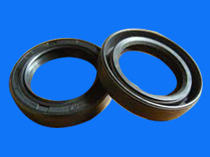
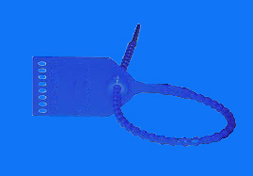
Template Comparison for SEAL
SEAL, OIL
SEAL, SECURITY
TYPE | M
INSIDE DIAMETER | M
OUTSIDE DIAMETER | M
THICKNESS | M
MATERIAL | M
SEALING MEMBER | O
SPRING LOADED | O
TEMPERATURE RATING | O
CONSTRUCTION | O
SPECIFICATION | O
STANDARD | O
TYPE | M
LOCKING METHOD | M
DIMENSIONS | M
SEAL MATERIAL | M
STRENGTH | O
CABLE MATERIAL | O
CABLE LENGTH | O
COLOR | O
INSCRIPTION | O
APPLICATION | O
SPECIFICATION | O
STANDARD | O
A split or solid rubber, felt, leather or composition ring-shaped item, which may or may not be encased, with or without spring or spreader for effective sealing and designed to be bolt or press mounted between fixed and moveable parts.
A lead-and-wire seal, or similar non-reusable closure, attached to a weighing or measuring instrument or device for protection against undetectable access, removal, adjustment or unauthorized use.
Possible Types for Oil Seal: Lip/Radial Lip/Shaft/Ring/Rod
Possible Types for Security Seal: Cinch-up/Lock/Rope Wire
UNSPSC: 31411705/Lip Seal
UNSPSC: 24141504/Tamper Proof or Security Seals
By looking at both the images, both are completely different, “OIL SEAL” is used between rotating and stationary machine components, whereas “SECURITY SEAL” is used for protection against undetectable access, etc., and they are classified with two different UNSPSC Classifications as mentioned above.

Slide 44
Gap Analysis – Template Summary
S. No | Description | Count
1 | Total Proposed templates | 1,839
2 | No of Approved templates | 654
3 | No of Unapproved templates | 1,185
Every approved template has change in properties

Slide 45
Gap Analysis – Template Comparison 1
CLASS | PROPERTY | Remarks
TUBE, METALLIC | TYPE
TUBE, METALLIC | INSIDE DIAMETER
TUBE, METALLIC | OUTSIDE DIAMETER
TUBE, METALLIC | LENGTH
TUBE, METALLIC | WIDTH
TUBE, METALLIC | WALL THICKNESS | Standard wire gauge is the unit of measure for Wall Thickness, so it cannot be considered as one of the Property
TUBE, METALLIC | STANDARD WIRE GAUGE
TUBE, METALLIC | END TYPE
TUBE, METALLIC | PROCESS
TUBE, METALLIC | STRUCTURE
TUBE, METALLIC | SURFACE TREATMENT | These 3 properties are similar and the same type of value will be updated, so better we should avoid the synonyms
TUBE, METALLIC | SURFACE FINISH
TUBE, METALLIC | COATING
TUBE, METALLIC | SHAPE

Slide 46
Gap Analysis – Template Comparison 2
Class | Property | Remarks
HOSE ASSEMBLY, METALLIC | TYPE
HOSE ASSEMBLY, METALLIC | HOSE SIZE | IN HOSE SIZE, Dimensions will be added again Inside diameter and outside diameter properties are proposed
HOSE ASSEMBLY, METALLIC | INSIDE DIAMETER
HOSE ASSEMBLY, METALLIC | OUTSIDE DIAMETER
HOSE ASSEMBLY, METALLIC | LENGTH
HOSE ASSEMBLY, METALLIC | CONNECTION 1 TYPE
HOSE ASSEMBLY, METALLIC | CONNECTION 1 SIZE
HOSE ASSEMBLY, METALLIC | CONNECTION 2 TYPE
HOSE ASSEMBLY, METALLIC | CONNECTION 2 SIZE
HOSE ASSEMBLY, METALLIC | MATERIAL
HOSE ASSEMBLY, METALLIC | MATERIAL SPECIFICATION
HOSE ASSEMBLY, METALLIC | HOSE LINING MATERIAL
HOSE ASSEMBLY, METALLIC | HOSE REINFORCEMENT | Both are synonym Properties where material will be added
HOSE ASSEMBLY, METALLIC | HOSE BRAID MATERIAL
HOSE ASSEMBLY, METALLIC | HOSE FINISH
HOSE ASSEMBLY, METALLIC | HOSE CONSTRUCTION | Same Property value will be added
HOSE ASSEMBLY, METALLIC | MANUFACTURING PROCESS
HOSE ASSEMBLY, METALLIC | MEDIUM
HOSE ASSEMBLY, METALLIC | MINIMUM INSIDE BENDING RADIUS
HOSE ASSEMBLY, METALLIC | DESIGN SPECIFICATION
HOSE ASSEMBLY, METALLIC | EXTERIOR COLOR
HOSE ASSEMBLY, METALLIC | PRESSURE RATING
HOSE ASSEMBLY, METALLIC | OPERATING TEMPERATURE
HOSE ASSEMBLY, METALLIC | APPLICATION
HOSE ASSEMBLY, METALLIC | SPECIFICATION
HOSE ASSEMBLY, METALLIC | STANDARD

Slide 47
Gap Analysis – Template Comparison 3
Class | Property name | Remarks
BEARING, SLEEVE | TYPE
BEARING, SLEEVE | INSIDE DIAMETER
BEARING, SLEEVE | OUTSIDE DIAMETER
BEARING, SLEEVE | WIDTH
BEARING, SLEEVE | MATERIAL
BEARING, SLEEVE | MATERIAL SPECIFICATION
BEARING, SLEEVE | MATERIAL GRADE
BEARING, SLEEVE | STYLE
BEARING, SLEEVE | INNER RING MATERIAL
BEARING, SLEEVE | OUTER RING MATERIAL
BEARING, SLEEVE | SEALING
BEARING, SLEEVE | SEALING TYPE
BEARING, SLEEVE | PIECE QUANTITY
BEARING, SLEEVE | LUBRICATION METHOD
BEARING, SLEEVE | SPEED
BEARING, SLEEVE | LOAD CAPACITY
BEARING, SLEEVE | PACKAGE TYPE
BEARING, SLEEVE | IBI
BEARING, SLEEVE | LENGTH
BEARING, SLEEVE | APPLICATION
BEARING, SLEEVE | SPECIFICATION
BEARING, SLEEVE | STANDARD

Slide 48
Gap Analysis – Template Comparison 3
Class | Property name | Remarks
BEND, PIPE | TYPE
BEND, PIPE | PIPE SIZE
BEND, PIPE | ANGLE
BEND, PIPE | RADIUS
BEND, PIPE | OUTSIDE DIAMETER
BEND, PIPE | CONNECTION SIZE
BEND, PIPE | CONNECTION TYPE
BEND, PIPE | MATERIAL
BEND, PIPE | MATERIAL SPECIFICATION
BEND, PIPE | MATERIAL GRADE
BEND, PIPE | MANUFACTURING PROCESS
BEND, PIPE | SURFACE TREATMENT
BEND, PIPE | SCHEDULE
BEND, PIPE | TEMPERATURE RATING
BEND, PIPE | LINING
BEND, PIPE | MASS
BEND, PIPE | COATING
BEND, PIPE | FINISH
BEND, PIPE | TANGENT
BEND, PIPE | MEDIUM
BEND, PIPE | DUTY
BEND, PIPE | COLOUR
BEND, PIPE | CENTRE TO END
BEND, PIPE | CENTER TO CENTER
BEND, PIPE | CONSTRUCTION
BEND, PIPE | CENTER TO FACE DISTANCE
BEND, PIPE | WALL THICKNESS
BEND, PIPE | PRESSURE RATING
BEND, PIPE | APPLICATION
BEND, PIPE | SPECIFICATION
BEND, PIPE | STANDARD

Slide 49
Gap Analysis – Template Comparison 3
Class | Property name | Remarks
CASING, OCTG | NOMINAL SIZE
CASING, OCTG | WALL THICKNESS
CASING, OCTG | WEIGHT
CASING, OCTG | END CONNECTION
CASING, OCTG | CONNECTION TYPE
CASING, OCTG | CONNECTION SIZE
CASING, OCTG | MATERIAL
CASING, OCTG | MATERIAL SPECIFICATION
CASING, OCTG | MATERIAL GRADE
CASING, OCTG | PROCESS
CASING, OCTG | SURFACE TREATMENT
CASING, OCTG | LENGTH
CASING, OCTG | MARKING BAND 1
CASING, OCTG | MARKING BAND 2
CASING, OCTG | APPLICATION
CASING, OCTG | SPECIFICATION
CASING, OCTG | STANDARD
CASING, OCTG | BOTTOM CONNECTOR | 41 PROPERTIES ARE PROPOSED TO INCLUDE
CASING, OCTG | BOTTOM CONNECTOR THD
CASING, OCTG | COLLAR DATA
CASING, OCTG | CONNECTOR DATA
CASING, OCTG | CONSTRUCTION
CASING, OCTG | COUPLING
CASING, OCTG | COUPLING INT.SHOULDER
CASING, OCTG | COUPLING LENGTH
CASING, OCTG | COUPLING OUTSIDE DIA
CASING, OCTG | OUTSIDE DIAMETER
CASING, OCTG | PIPE INSIDE DIAMETER
CASING, OCTG | PIPE OUTSIDE DIAMETER
CASING, OCTG | RUNNING LENGTH
CASING, OCTG | MEDIUM
CASING, OCTG | SIZE
CASING, OCTG | SURFACE COATING
CASING, OCTG | THREAD
CASING, OCTG | THREAD COMPOUND
CASING, OCTG | THREAD GREASE
CASING, OCTG | COUPLING TYPE
CASING, OCTG | DESIGN SPEC
CASING, OCTG | DRIFT
CASING, OCTG | DRIFT SIZE
CASING, OCTG | END DATA
CASING, OCTG | END PROTECTION
CASING, OCTG | FINISH
CASING, OCTG | GRADE/TYPE
CASING, OCTG | INSIDE DIAMETER
CASING, OCTG | INTERNAL COATING
CASING, OCTG | JOINT TYPE
CASING, OCTG | LENGTH RANGE
CASING, OCTG | MANUFACTURING PROCESS
CASING, OCTG | MATERIAL
CASING, OCTG | MATERIAL GRADE
CASING, OCTG | MATERIAL SPEC
CASING, OCTG | THREAD PROTECTOR
CASING, OCTG | THREAD SPEC
CASING, OCTG | TOP CONNECTOR
CASING, OCTG | TOP CONNECTOR THD
CASING, OCTG | WALL THICKNESS
CASING, OCTG | WEIGHT

Slide 50
Thank You
Notes:
50

